Slide 1

ATLIQ HARDWARE
Consumer Goods AD-HOC Insights
Presented By
Rohan Dhainje

Slide 2
Agenda
Company Overview
Problem Statement
Dataset Overview
Database Schema
Tools Used
Ad-Hoc Business Requests & Insights
Recommendations
Thank You

Slide 3

Company Overview
AtliQ Hardware is a consumer goods company.
It manufactures and sells computer hardware products.
The company operates in multiple markets and sales channels.
The management team requested 10 ad-hoc business requests to gain insights and support data-driven decision-making.

Slide 4
Problem Statement
Management noticed a lack of insights for quick, smart data-informed decisions.
Decision made to expand the data analytics team with several junior data analysts.
Tony Sharma, the data analytics director, seeks candidates with strong tech and soft skills.
To evaluate these skills, Tony decided to conduct a SQL challenge.

Slide 5
Dataset Overview
The dataset is based on AtliQ Hardware, a consumer goods company.
It contains sales, customer, product, pricing, manufacturing cost, and discount data.
The analysis covers Fiscal Years 2020 and 2021.
The dataset includes multiple markets, sales channels, and product divisions.
It consists of 6 main tables:
Dim Customer
Dim Product
Fact Sales Monthly
Fact Gross Price
Fact Manufacturing Cost
Fact Pre Invoice Deductions

Slide 6

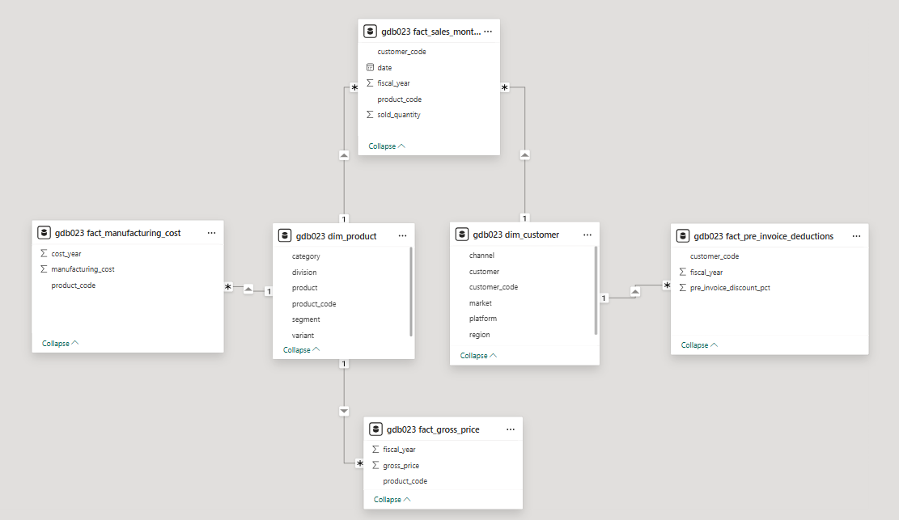
Database Schema

Slide 7




Tools used

Slide 8
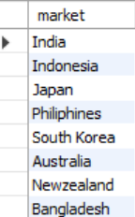
Ad-hoc requests and insights
Request 1 :
Provide the list of markets in which customer "AtliQ Exclusive" operates its business in the APAC region.

Slide 9
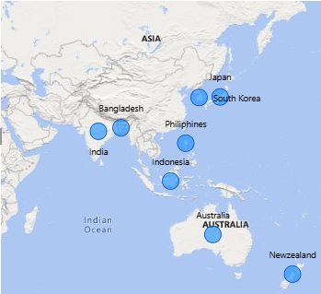
Insights:
AtliQ Exclusive operates in 8 markets within the APAC region, indicating a strong regional presence.

Slide 10

Request 2 :
What is the percentage of unique product increase in 2021 vs. 2020? The final output contains these fields, unique_products_2020 ,unique_products_2021
percentage_chg .

Slide 11
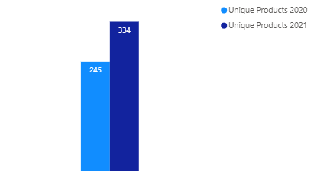
36.33 %
Insights:
The number of unique products increased by 36.33 % in 2021 compared to 2020.
The increase reflects the company's focus on expanding its product range.

Slide 12
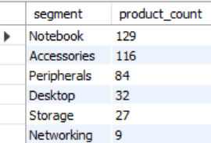
Request 3 :
Provide a report with all the unique product counts for each segment and sort them in descending order of product counts. The final output contains 2 fields, segment and product_count.

Slide 13
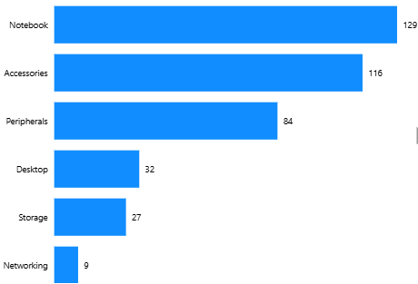
Insights:
82.87% of the total unique products belong to the Notebook, Accessories, and Peripherals segments.
Only 17.13% of the total unique products belong to Desktop, Storage, and Networking segments.

Slide 14
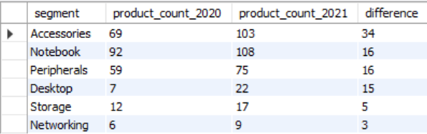
Request 4 :
Follow-up: Which segment had the most increase in unique products in 2021 vs 2020? The final output contains these fields, segment , product_count_2020, product_count_2021 and difference.

Slide 15
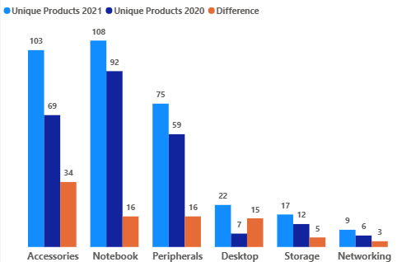
Insights:
Accessories had the highest increase, adding 34 unique products in 2021.
Notebook and Peripherals each added 16 unique products.
Networking had the smallest increase, with only 3 new products.

Slide 16

Request 5 :
Get the products that have the highest and lowest manufacturing costs. The final output should contain these fields, product_code,
product, manufacturing_cost.

Slide 17
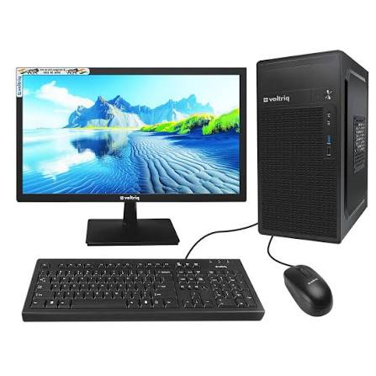
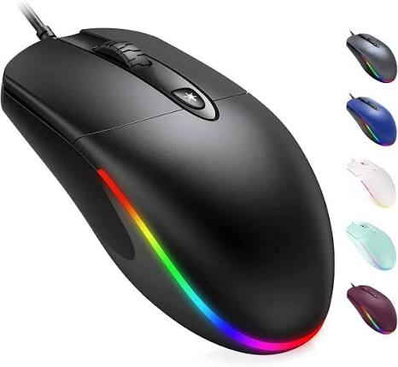
Highest manufacturing cost
Lowest manufacturing cost
AQ HOME Allin1 Gen 2
240.54$
AQ Master wired x1 Ms
0.89$
Insights:
AQ HOME Allin1 Gen 2 has the highest manufacturing cost of 240.54, while AQ Master wired x1 Ms has the lowest manufacturing cost of 0.89.

Slide 18
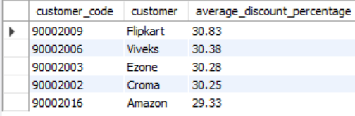
Request 6 :
Generate a report which contains the top 5 customers who received an average high pre_invoice_discount_pct for the fiscal year 2021 and in the Indian market. The final output contains these fields, customer_code, customer, average_discount_percentage.

Slide 19
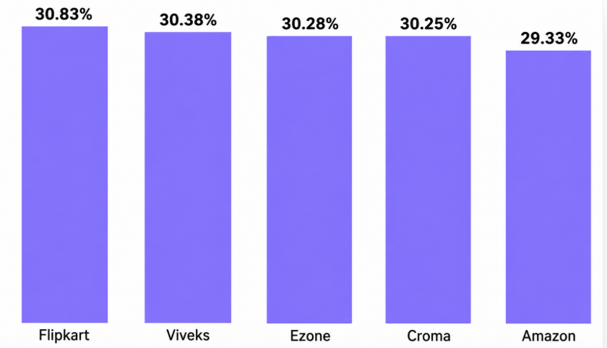
Insights:
Flipkart received the highest average pre-invoice discount at 30.83%, followed by Viveks (30.38%), Ezone (30.28%), Croma (30.25%), and Amazon (29.33%).
The average pre-invoice discounts for the top 5 customers are very close, ranging from 29.33% to 30.83%, indicating that similar discount percentages were offered to all of them.

Slide 20
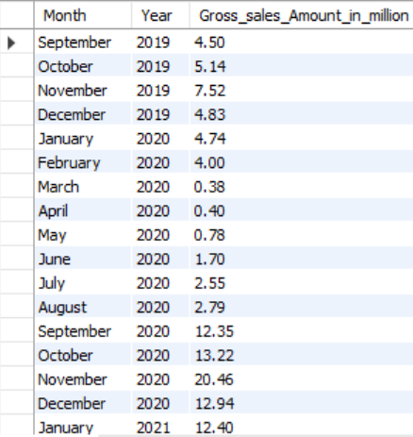
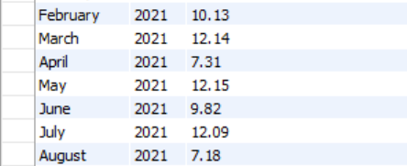
Request 7 :
Get the complete report of the Gross sales amount for the customer “Atliq Exclusive” for each month. This analysis helps to get an idea of low and high-performing months and take strategic decisions. The final report contains these columns: Month, Year and Gross sales Amount.

Slide 21
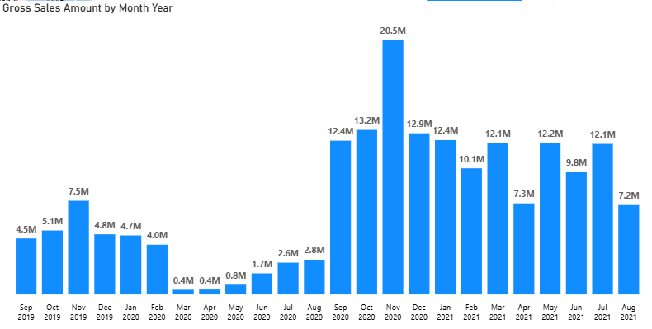
Insights:
Gross sales dropped sharply in March 2020 (0.4M), which may be associated with the business disruption caused by the COVID-19 pandemic.
Gross sales recovered strongly from September 2020, reaching a peak of 20.5M in November 2020, indicating a significant improvement in sales performance.

Slide 22
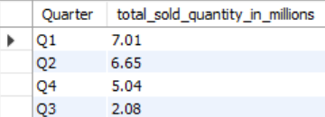
Request 8 :
In which quarter of 2020, got the maximum total_sold_quantity? The final output contains these fields sorted by the total_sold_quantity, Quarter and total_sold_quantity

Slide 23
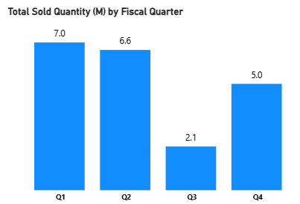
Insights:
Q1 recorded the highest total sold quantity at 7.0M units, followed by Q2 (6.6M) and Q4 (5.0M).
Total sold quantity dropped sharply in Q3 to 2.1M units, indicating a significant decline in demand. Sales recovered in Q4, increasing to 5.0M units.
The sharp decline in Q3 may be associated with the business disruption caused by the COVID-19 pandemic, while Q4 shows a recovery in sales.

Slide 24
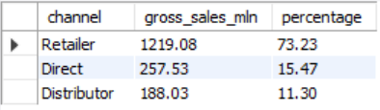
Request 9 :
Which channel helped to bring more gross sales in the fiscal year 2021 and the percentage of contribution? The final output contains these fields, channel, gross_sales_mln and percentage.

Slide 25
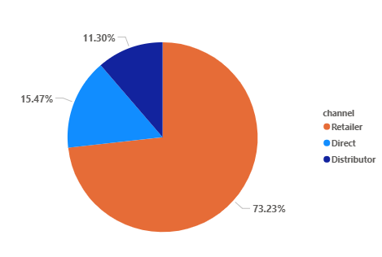
Insights:
Retailer is the highest performing channel, contributing 1219.08 M in gross sales, which accounts for 73.23% of the total gross sales in FY2021.
Direct and Distributor channels contributed 15.47% and 11.30%, respectively, together accounting for approximately 26.77% of the total gross sales .
The business is highly dependent on the Retailer channel , as it generates nearly three - fourths of the total gross sales.

Slide 26
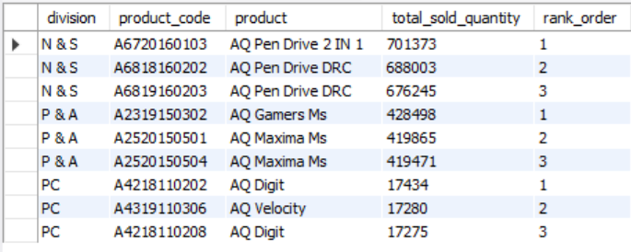
Request 10 :
Get the Top 3 products in each division that have a high total_sold_quantity in the fiscal_year 2021? The final output contains these fields, division, product_code , product, total_sold_quantity and rank_order.

Slide 27
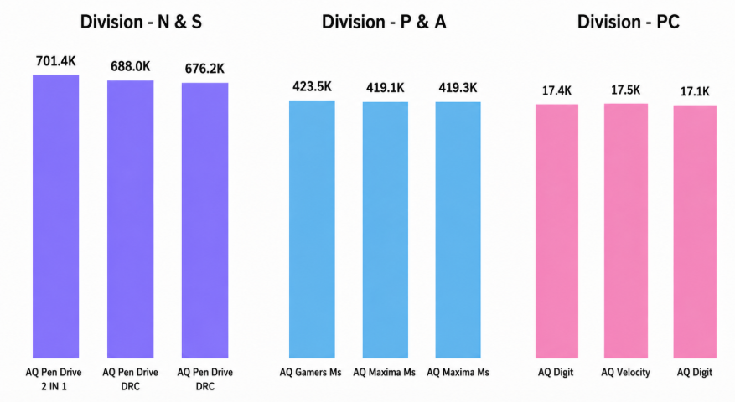
Insights:
N & S Division has the highest-selling products. AQ Pen Drive 2 IN 1 is the best-selling product with 701.4K units.
P & A Division is led by AQ Gamers Ms, followed by two AQ Maxima Ms products.
PC Division has the lowest sales among all divisions. AQ Digit and AQ Velocity are its top-selling products.
Overall, N & S performs the best, while PC has the lowest demand.

Slide 28
Recommendations
Increase focus on top-selling products like AQ Pen Drive 2 IN 1 to increase sales.
Improve marketing for low-performing products to increase customer demand.
Expand the Retailer channel, as it generates the highest gross sales.
Offer more discounts during festival seasons to boost sales, as demand increases during this period.
Analyze the reasons for low sales in the PC division and improve its product strategy.
Maintain enough stock for high-demand products to avoid stock shortages during peak sales periods.

Slide 29
Thank you!

